Slide 1
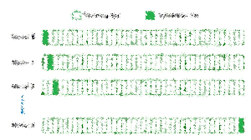

Lecture 14-2: Cross Validation
CSE445 Machine Learning
Dr. Jilan Samiuddin (JSA)
Assistant Professor
North South University

Slide 2
Introduction
Cross-validation is a technique used to evaluate how well a machine learning model performs on unseen data
It splits the dataset into several parts (or folds)
The model is trained on some parts (training set) and tested on the remaining part (validation set)
This process is repeated multiple times, each time with a different fold used as the validation set
The results from all validation steps are averaged to produce a more accurate estimate of the model's performance.
The main purpose of cross validation is to check for and prevent overfitting
If you want to make sure your machine learning model is not just memorizing the training data but is capable of adapting to real-world data, cross-validation is a commonly used technique to assess the model

Slide 3
A Good ML Model
A good machine learning model performs well on both training data and unseen data
It effectively learns patterns from the training data
It generalizes well to new, unseen data
To assess how well a model learns and generalizes, its performance is monitored on both the training data and a separate validation or test dataset
Achieving a good balance between learning and generalization can be difficult
Two common issues that impact a model’s performance and ability to generalize are overfitting and underfitting
It avoids overfitting (memorizing the training data)
It avoids underfitting (failing to capture important patterns)

Slide 4
Bias and Variance in ML
Bias and variance are two main sources of error that affect a model’s performance and generalization
High bias occurs when the model is too simple and fails to capture the underlying patterns in the data
Leads to underfitting: poor performance on both training and test data
High variance occurs when the model is too complex and captures noise along with the data patterns
It happens when a machine learning model is too complex
Leads to overfitting: good performance on training data but poor on unseen data
Overfitting → High variance and low bias
Underfitting → High bias and low variance

Slide 5
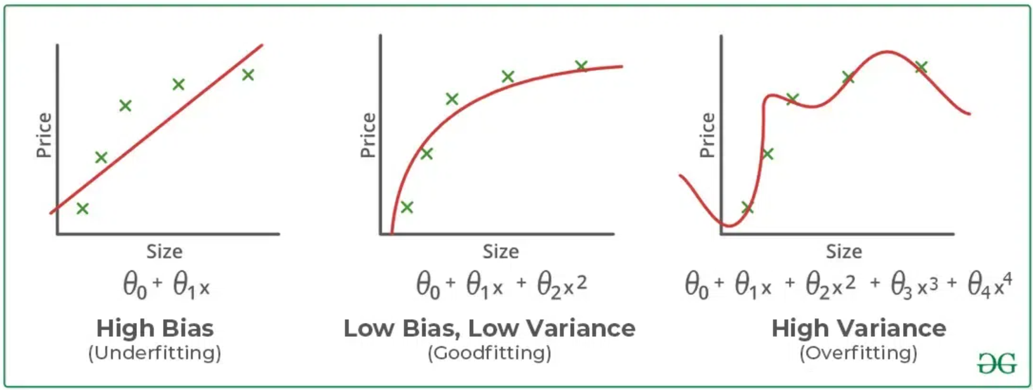
Bias and Variance in ML (contd.)
Underfitting: A straight line attempting to fit a curved dataset, failing to capture underlying patterns and resulting in poor performance on both training and test sets
Overfitting: A complex, squiggly curve that fits all training points perfectly but fails to generalize, leading to poor performance on test data
Proper Fitting: A curve that captures the true data trend without unnecessary complexity, balancing learning and generalization effectively.
Image source: GeeksForGeeks

Slide 6
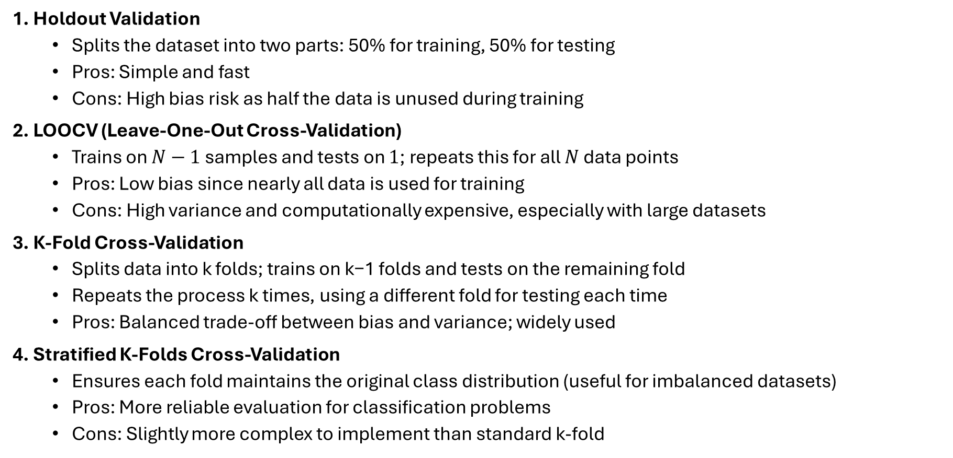
Types of Cross-Validation
1. Holdout Validation
Splits the dataset into two parts: 50% for training, 50% for testing
Pros: Simple and fast
Cons: High bias risk as half the data is unused during training
2. LOOCV (Leave-One-Out Cross-Validation)
Trains on $N−1$ samples and tests on $1$; repeats this for all $N$ data points
Pros: Low bias since nearly all data is used for training
Cons: High variance and computationally expensive, especially with large datasets
3. K-Fold Cross-Validation
Splits data into k folds; trains on k−1 folds and tests on the remaining fold
Repeats the process k times, using a different fold for testing each time
Pros: Balanced trade-off between bias and variance; widely used
4. Stratified K-Folds Cross-Validation
Ensures each fold maintains the original class distribution (useful for imbalanced datasets)
Pros: More reliable evaluation for classification problems
Cons: Slightly more complex to implement than standard k-fold

Slide 7
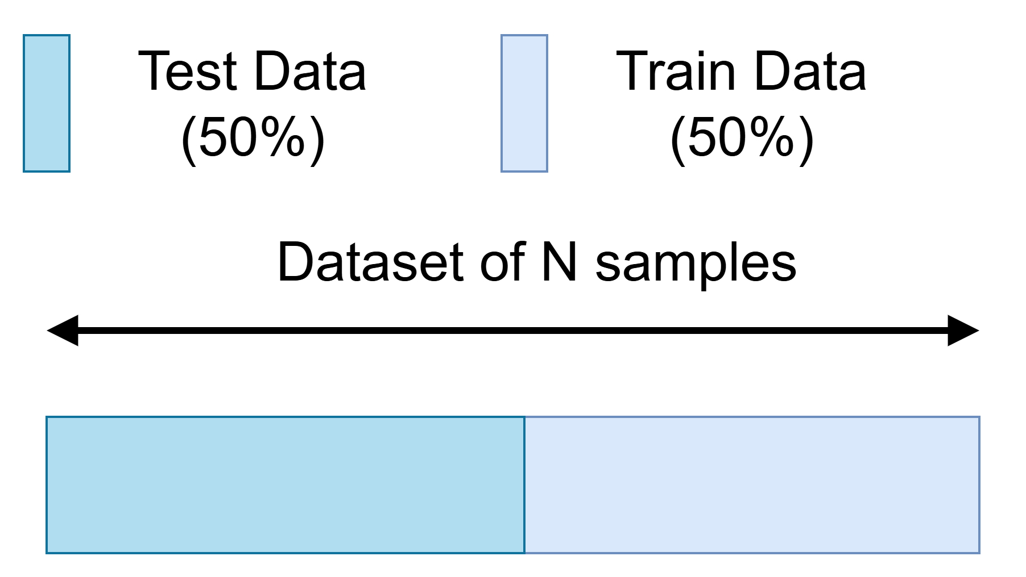
Holdout Cross Validation (LOOCV)
Use 50% of for training and 50% for testing
Number of cross validation iteration is one (1)

Slide 8
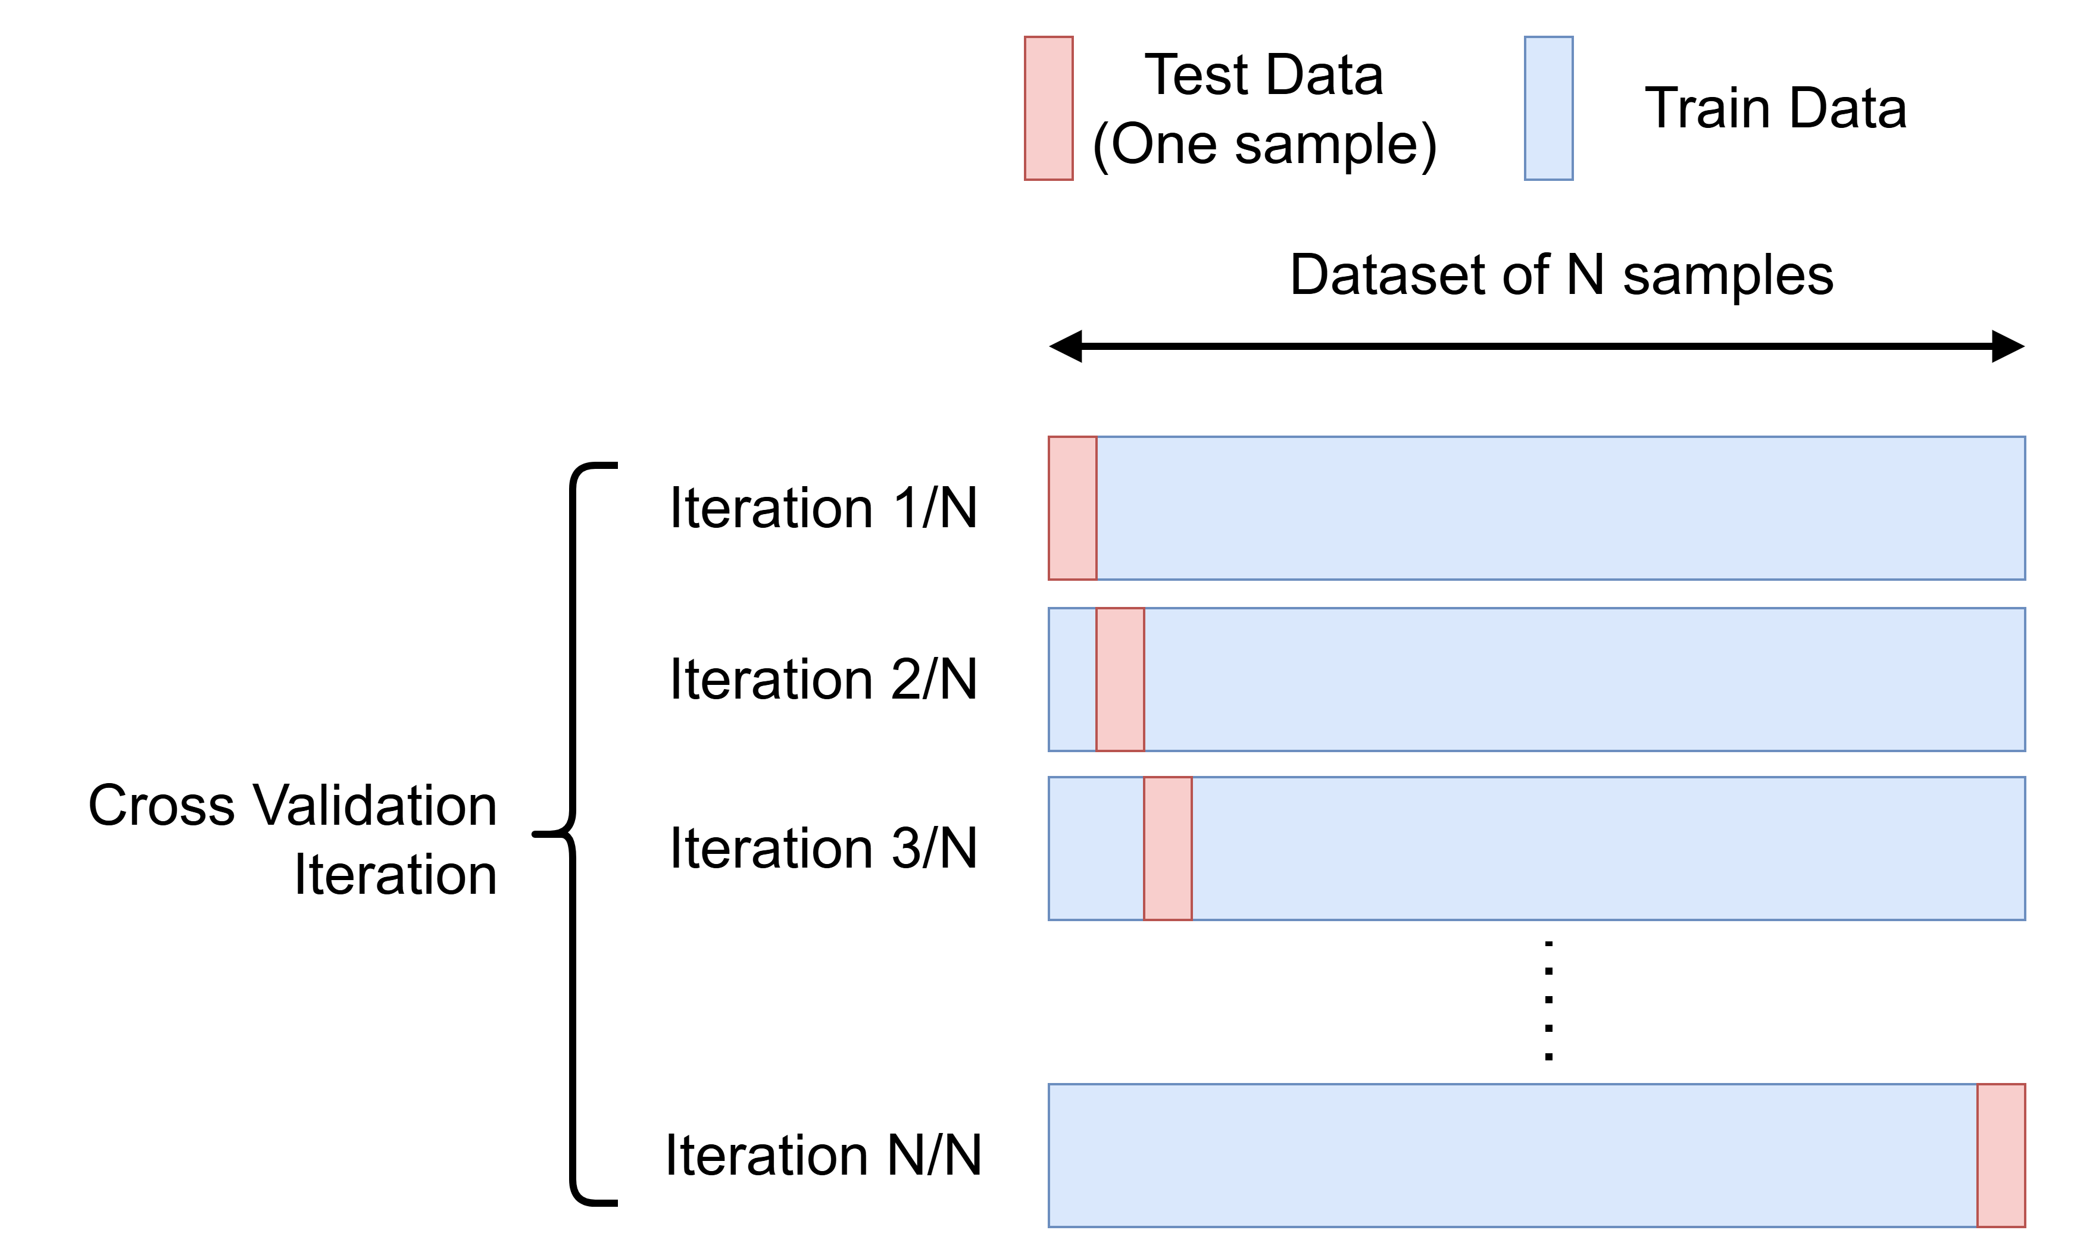

Leave-One-Out Cross Validation (LOOCV)
Trains on $N−1$ samples and tests on $1$
Repeats this for all $N$ data points

Slide 9
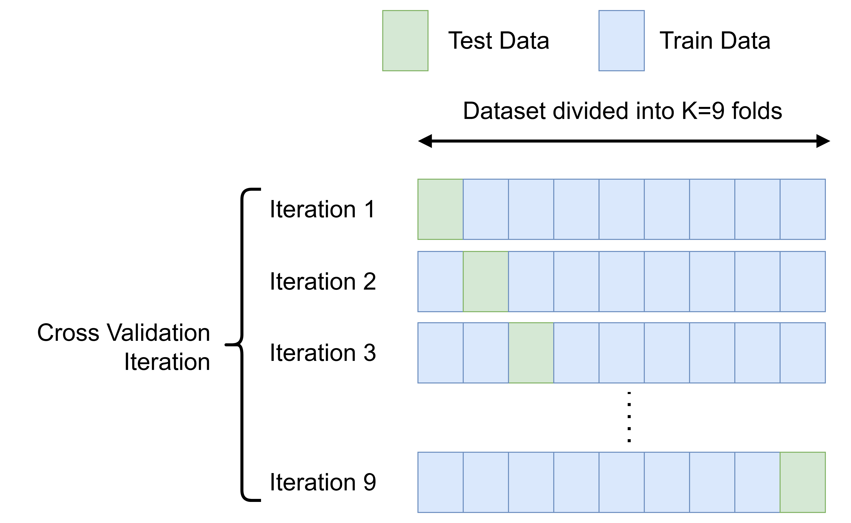
K-Fold Cross Validation
Splits data into K folds (partitions)
Trains on K−1 folds and tests on the remaining fold
Repeats the process K times, using a different fold for testing each time

Slide 10
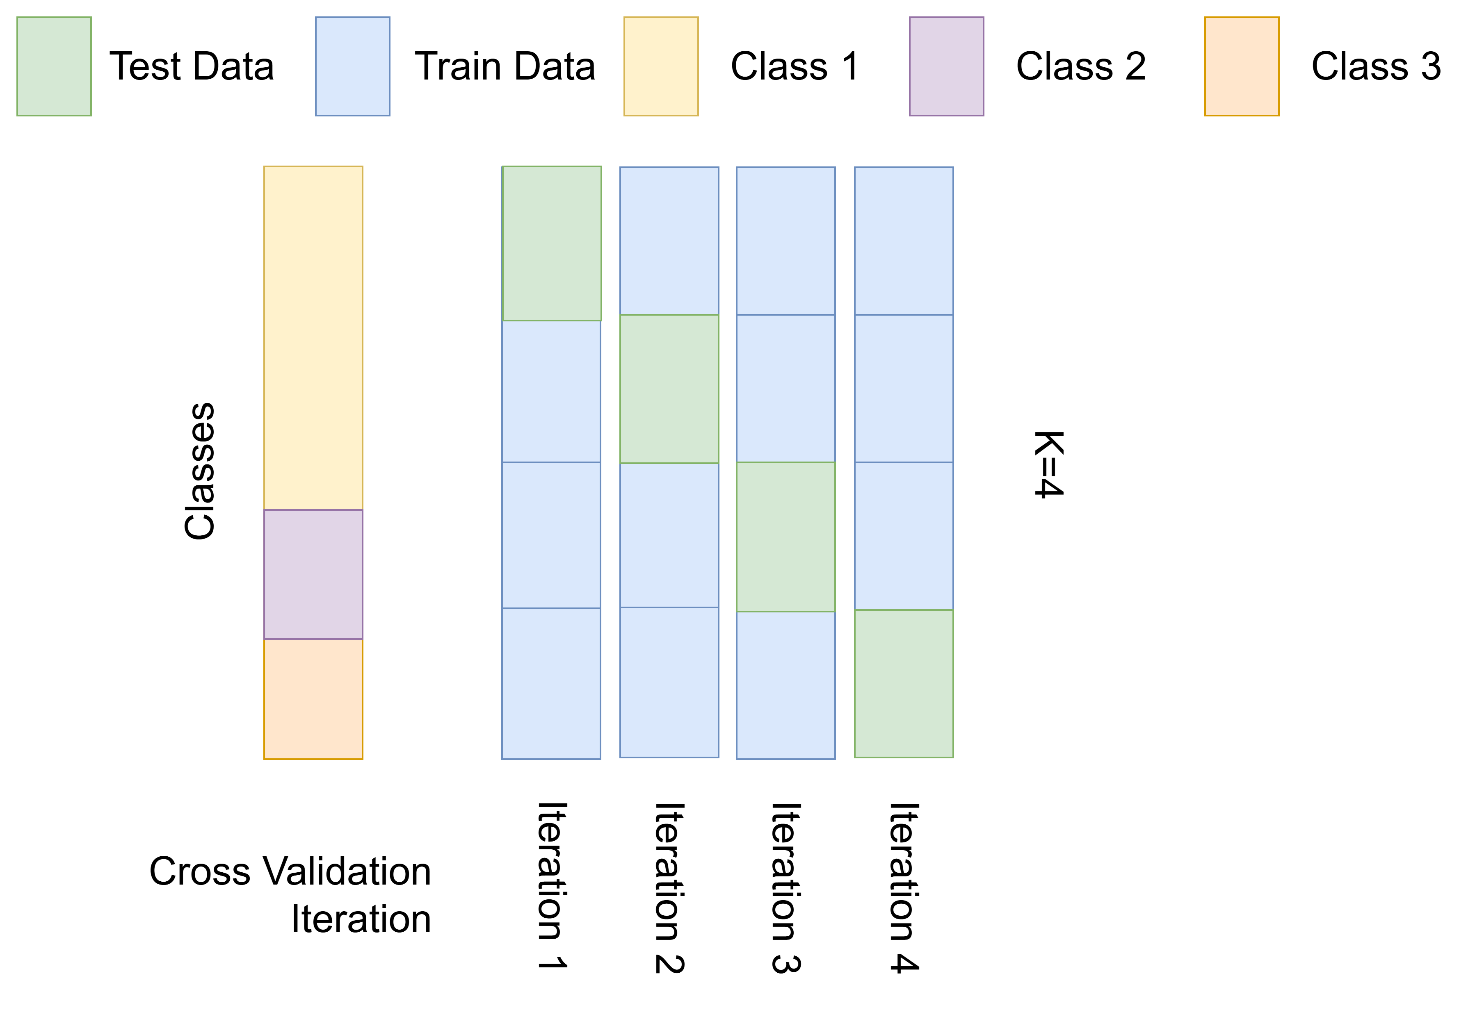
K-Fold Cross Validation: Issue
In each iteration, we are not taking equal representation of each class
For example, in iterations 1 and, only Class 1 is used for testing, and in iteration 4, Class 3 has not been used for training at all
Shuffling the data can potentially improve the situation

Slide 11

Stratified K-Folds Cross-Validation
The dataset is divided into K folds while maintaining the proportion of classes in each fold
For example, for K=4, each class is divided into 4 equal parts

Slide 12
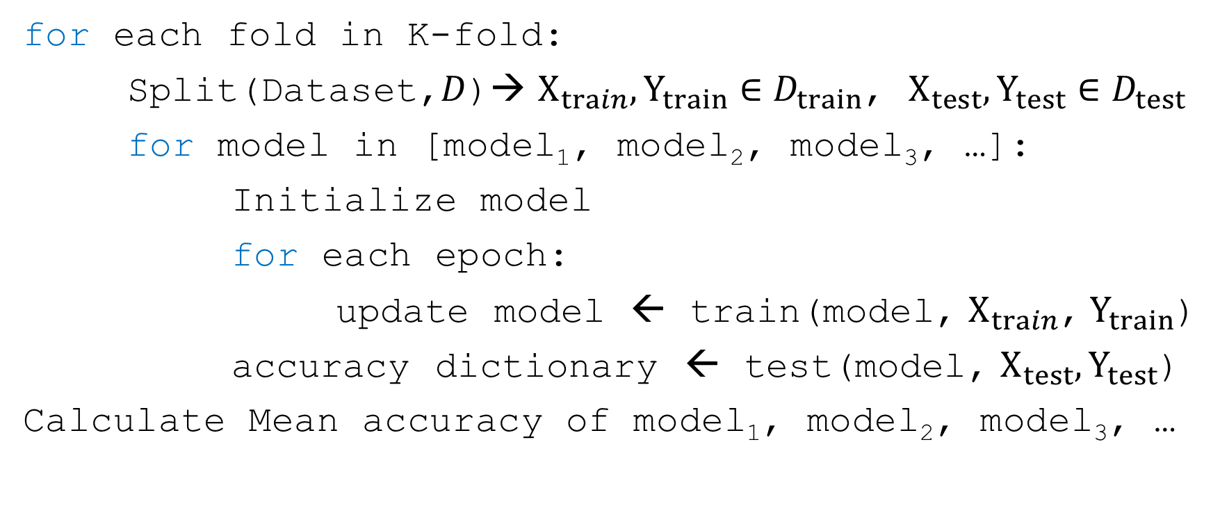
Pseudo Code
for each fold in K-fold:
Split(Dataset,$D$)→ $X_{train},Y_{train}∈D_{train}$, $X_{test},Y_{test}∈D_{test}$
for model in [model₁, model₂, model₃, …]:
Initialize model
for each epoch:
update model ← train(model, $X_{train}$, $Y_{train}$)
accuracy dictionary ← test(model, $X_{test},Y_{test}$)
Calculate Mean accuracy of model₁, model₂, model₃, …

Slide 13
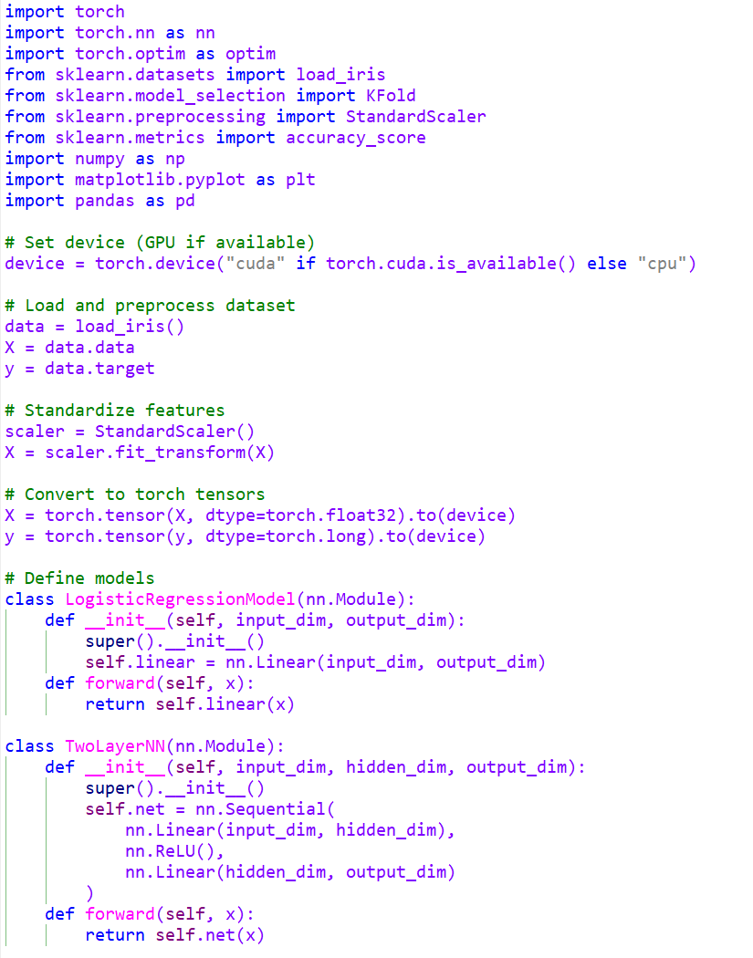
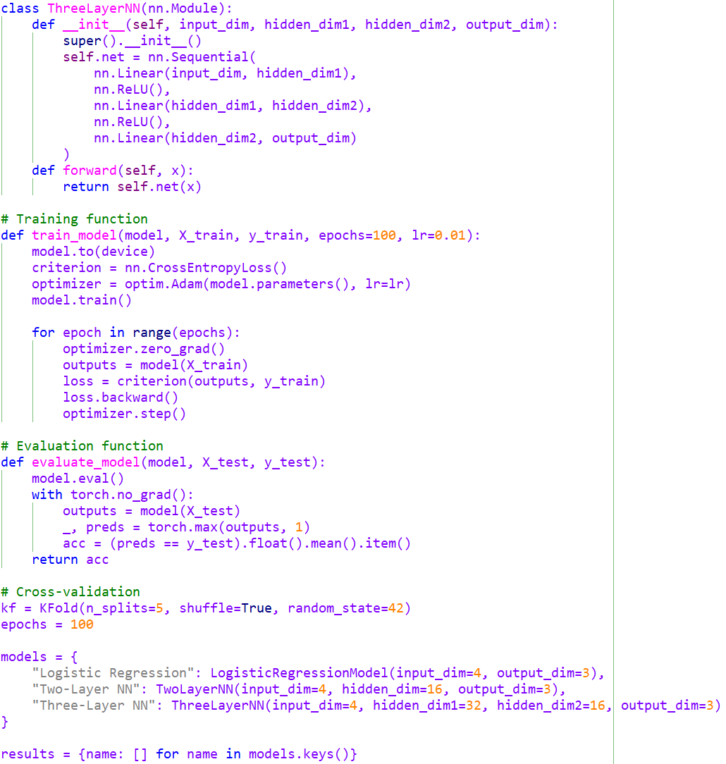
Python Example (contd.)

Slide 14
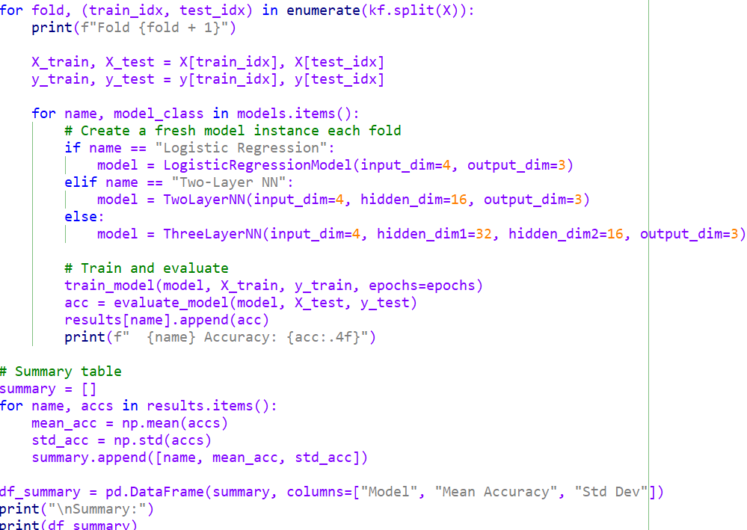
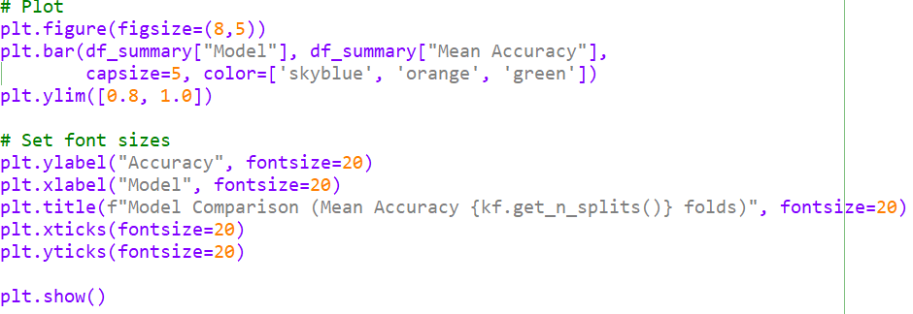
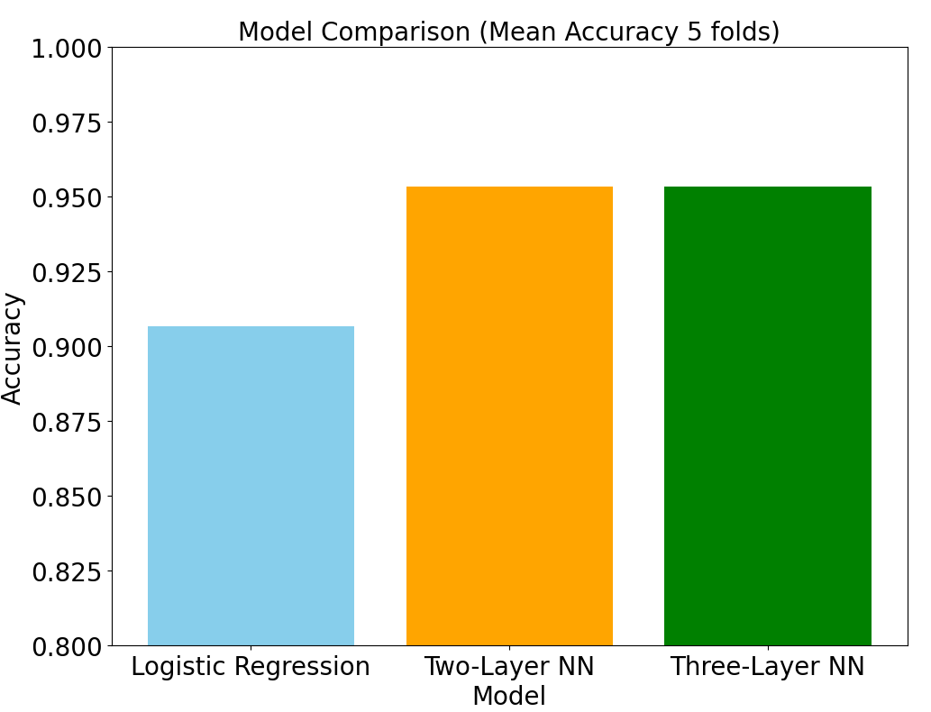
Python Example

